Slide 1


SYD366-ZDD GROUP PRESENTATION – PET GROOMING
PRESNTED BY: AARUSHI SOOD, NERON PARMAR, PRIYANKA

Slide 2


INTRODUCTION:
Christy is running a business of pet grooming. As she loves doing it. Apart from this, she takes her own trailer and truck and visits the house of her client, so that her client doesn’t gets troubled.
However, when it comes to keeping the records of the payments and her clients she misplaces that as she keeps it in notes of hardcopy only.

Slide 3
Reason for choosing
We have came up with an idea that could help her in keeping all the details and data safe and secure. As this app will store all the data of clients, their payments and all the receipts.
Therefore, this can help Christy to keep all data on hand and can access it whenever she needs. A safe and secure app for her use !

Slide 4
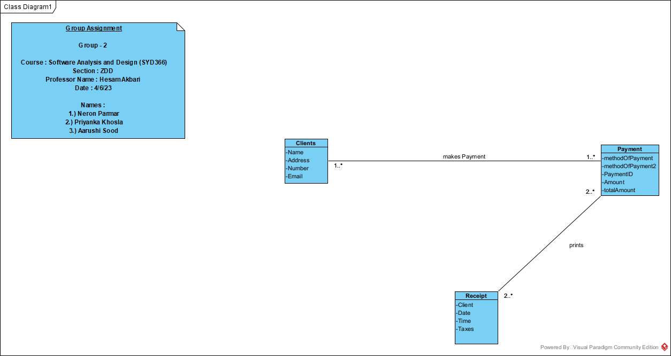
Class Diagram

Slide 5
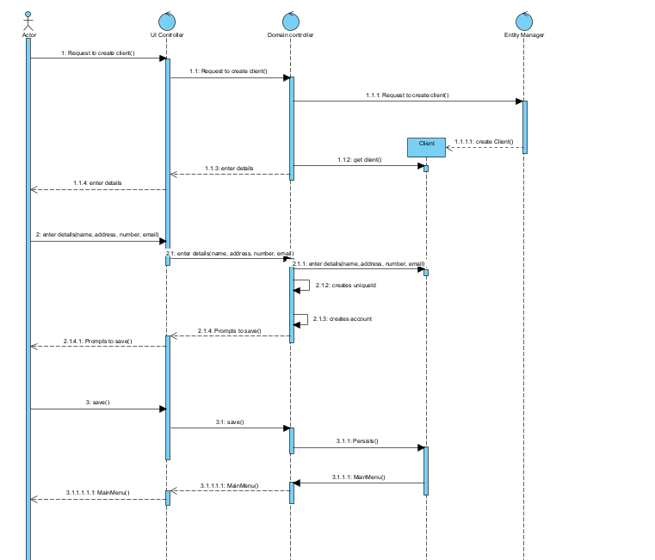
CASE 1:

Slide 6
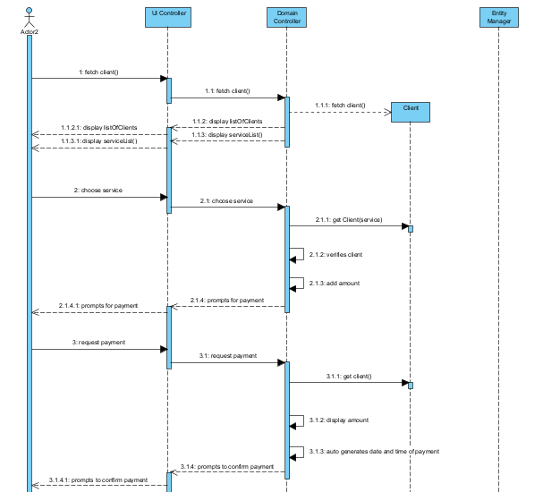
CASE2:

Slide 7
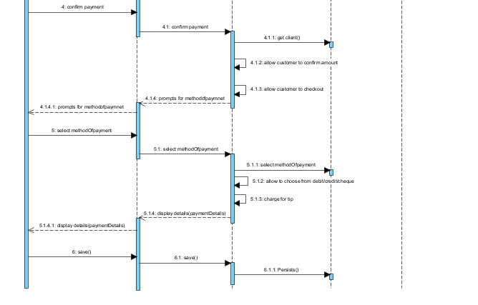

Slide 8
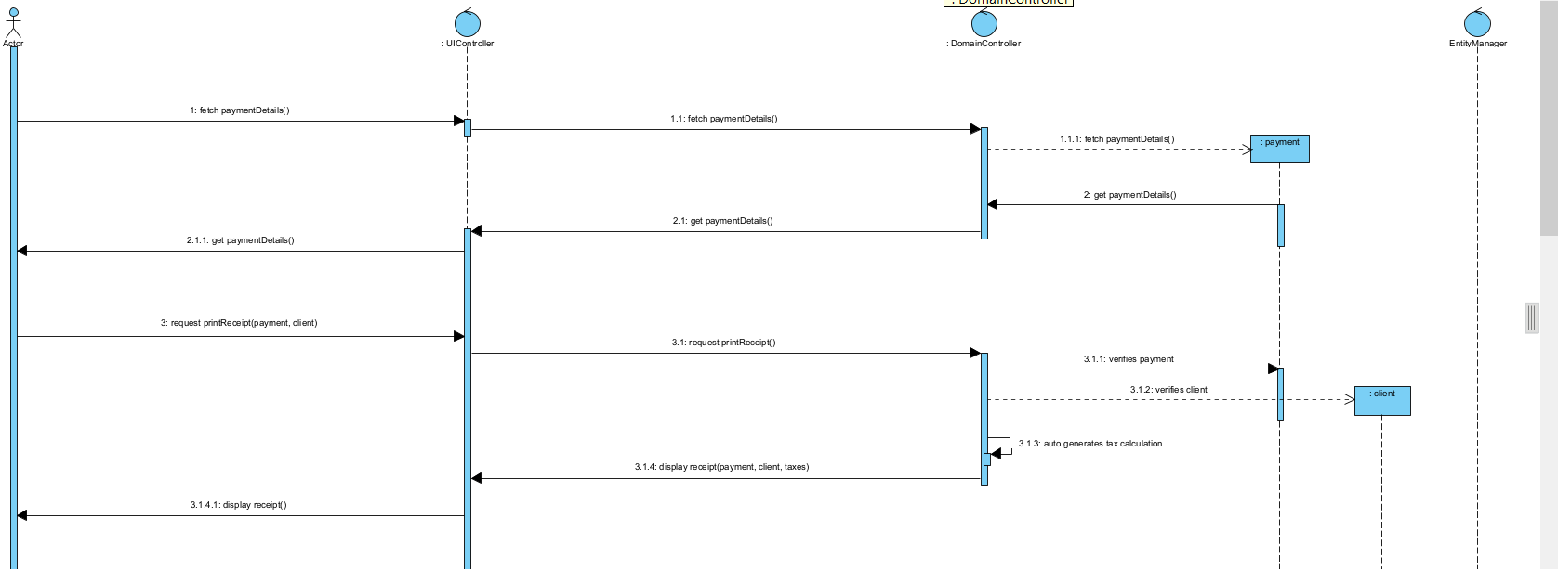
CASE3:

Slide 9
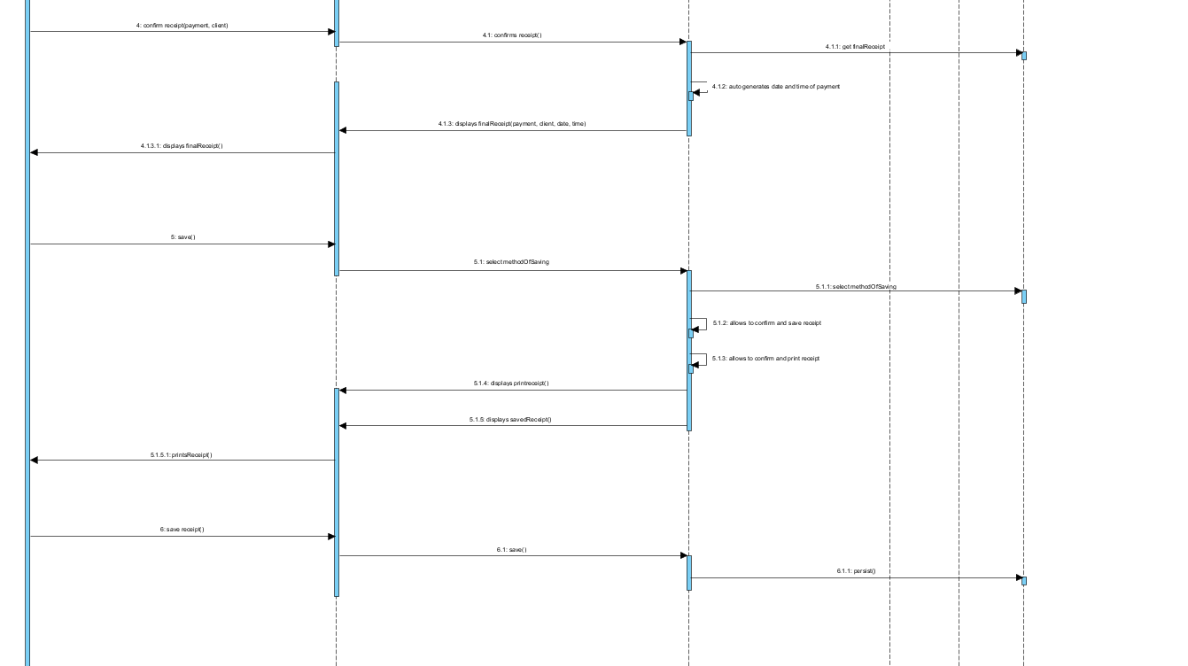

Slide 10
CONCLUSION
Christy will now be able to handle her taxes, invoices, and everything perfectly without loosing any kind of information or details.
Moreover, she can get the address of a client who had already done their pet grooming with Christy and can visit them whenever she gets the appointment and doesn’t have to ask for the address or any kind of details repeatedly.
Furthermore, when it comes to keeping the records she can have it in hardcopy as well as in device copy.
So, now Christy is completely trendy and progressive.

